Slide 1
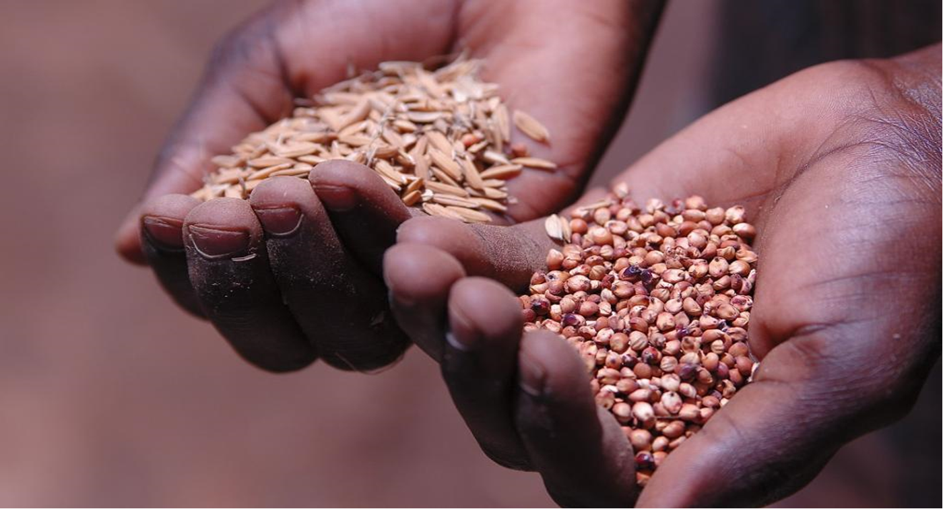




Nigerian Seed Roadmap Dashboard
State of the Nigerian Seed Sector
2023

Slide 2
Table of contents
1. Introduction
2. Nigeria roadmap overview
3. Methodology
4. Dashboard navigation
5. Nigeria Seed Sector Dashboard

Slide 3
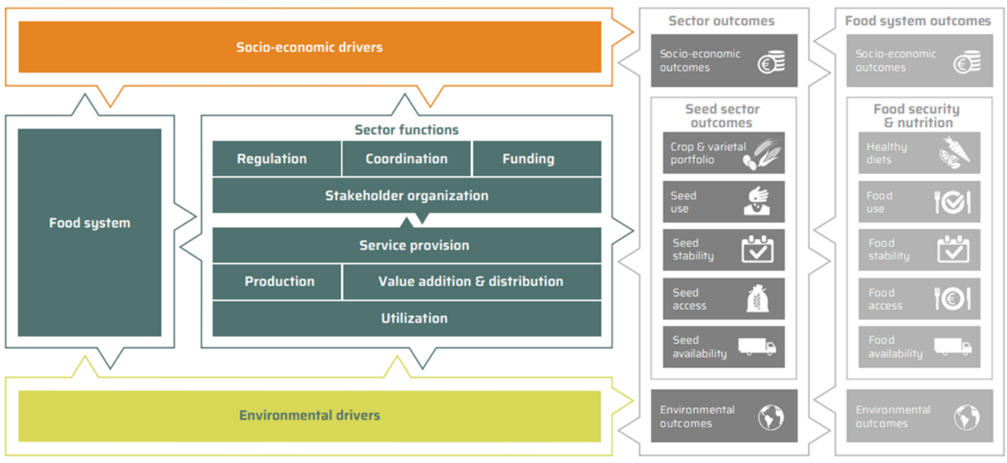








Introduction
The National seed road map (NSRM) is a strategic policy document that guides stakeholders in the seed sector of Nigeria to work towards an increase in farmers’ access to and use of quality seed of improved varieties. The document is a critical input to the development of major agricultural policies of the government, while it can also guide the government, stakeholders and development partners in exploring and agreeing on ways to foster the development of the sector in a coordinated, aligned and structured fashion.
Seed sector transformation framework: The seed sector transformation framework takes a holistic approach with complementary strategies for the development of the seed sector. The framework considers that a well-performing seed sector needs a strong production base; it needs to perform well in relation to the functions of (i) service provision, (ii) seed production, and (iii) market value addition and distribution and (iv) utilization; it needs an effective governance with (v) regulation, (vi) coordination, (vii) stakeholder organization and (viii) funding.
The NSRM dashboard showcases a comprehensive overview of the Nigerian seed sector performance. The dashboard focuses on the 5-year horizon of the sector.
The dashboard includes the 22 topics of the NSRM, and they are categorized by the functions of the framework.
The data in the dashboard is provided by the Nigerian seed sector experts.
The dashboard will be updated every year.
Click here for the National Seed Roadmap (NSRM) and detailed (SIP)
Source: De Boef & Thijssen, 2023 | Adapted the description of the sector functions from the roadmap document. The framework has been updated after the NSRM for Nigeria was developed.

Slide 4






Nigeria roadmap overview
 | SERVICE PROVISION
 | Decentralization of seed quality assurance
 | Professional variety development
 | PRODUCTION SYSTEMS
 | Early generation seed supply
 | Infrastructural capacity for seed production & marketing
 | Company professionalization & specialization
 | Community-based seed production
 | MARKET DEVELOPMENT
 | Extension on seed & cultivation practices
 | Tackling of counterfeit seed
 | Seed company marketing & promotion
 | Crop value chains & food security policies stimulating seed demand
 | Seed distribution networks
 | Institutional markets
 | REVENUE GENERATION & REINVESTMENT
 | Revenue generation for seed quality assurance
 | Financial services & products
 | COORDINATION & GOVERNANCE
 | Sector governance & coordination
 | Seed information
 | Seed trade association
 | Alignment of donor interventions
 | REGULATION & MANAGEMENT
 | Plant variety protection
 | Variety release
 | Seed import
 | Seed export
Click here for the National Seed Roadmap (NSRM) and detailed (SIP)

Slide 5

Methodology
1 | Indicators : The indicators are developed from the national seed roadmap (NSRM). The indicators are developed based on the ambitions (targets). The Nigerian seed sector experts review and approve the final indicators and their weighted average. Some topics of the NSRM have between 2 and 5 ambitions, hence the difference in the number of indicators per topic. Please note that the indicators can be updated as the targets are achieved.
2 | Verification and confirmation of the indicators: The indicators, from the ambitions, are the targets for the sector. The national seed experts verify the weight and the score of the indicators. The dashboard focuses on the 5-year horizon of the sector – as mentioned in the NSRM.
3 | Scoring : The score for each indicator ranges: 5, 25, 50, 75, 100. Nigerian seed sector experts do the scoring. Each indicator includes performance parameters. These parameters highlight the stages of the indicator, from poor performance (score 5) and best performance (score 100). At score 100, the target has been met. Each performance indicator includes the weighted average. The weighted average specifies the importance of the indicator to achieving the targets of the topics and functions of the sector. The dashboard database includes quantifiable rubrics. This is used by the Nigerian seed sector expert to score the sector.
4 | Data processing and database: A dashboard database is developed to collect the data. The database includes all the scores for each indicator. The scores are computed in the database, and this provides final performance score. Individual contributions by industry stakeholders are collated by NASC. The database is managed by NASC and not accessible by industry stakeholders.
5 | Dashboard visual: Results are included in this visual document. It illustrates the overall performance and individual topic performances.
6 | Validation: The visual is validated by the industry stakeholders through the seed sector platform organised by NASC.
7 | Dissemination: The dashboard is disseminated by NASC on their website and on the Nigeria seed portal.
Data sources
CSP | Collaborative Seed Programme
FMAFS | Federal Ministry of Agriculture, Food and Security
NACGRAB | National Centre for Genetic Resources and Biotechnology
NAERLS | National Agricultural Extension And Research Liaison Services
NARIS | National Agricultural Research Institutes
NASC | National Agricultural Seed Council
SEEDAN | Seed Association of Nigeria
Sahel Consulting | Sahel Consulting Agriculture & Nutrition ltd
TASAI | The African Seed Access Index

Slide 6
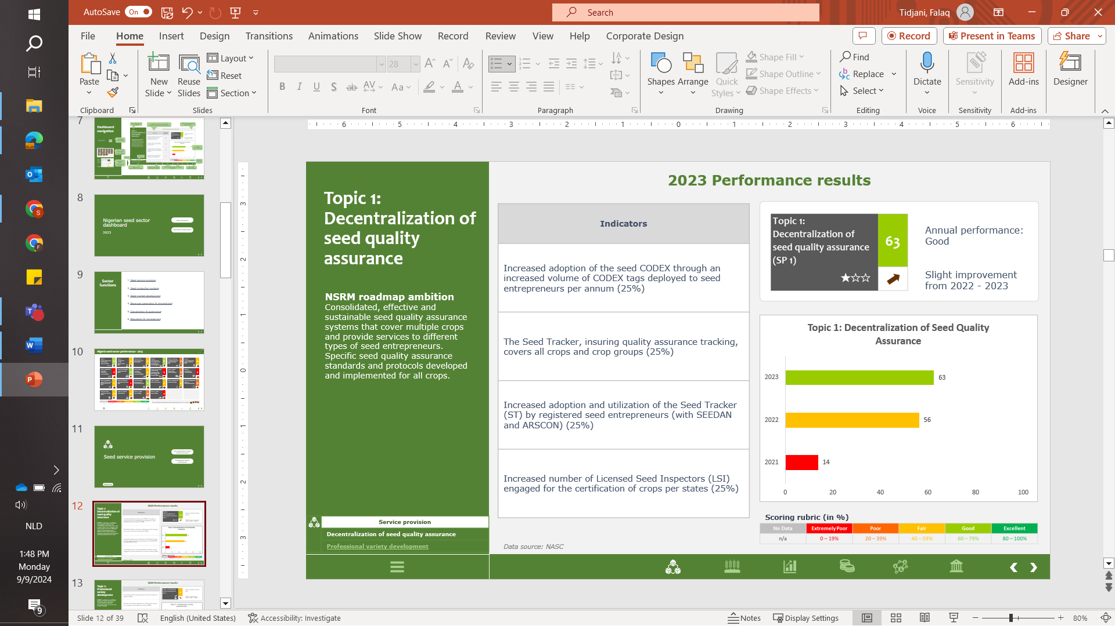

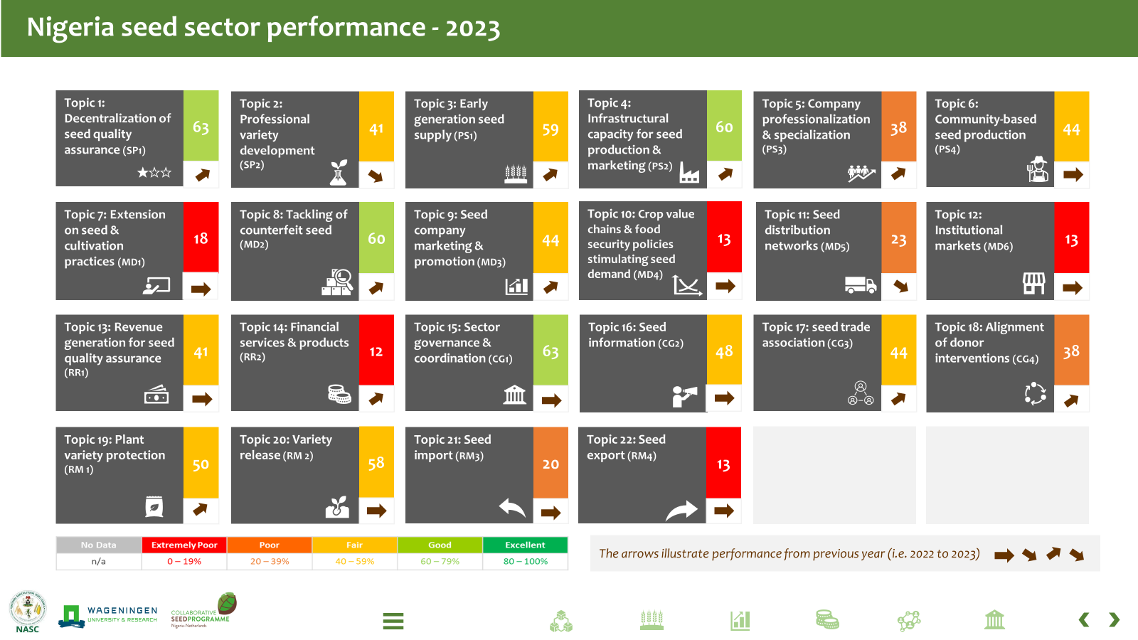
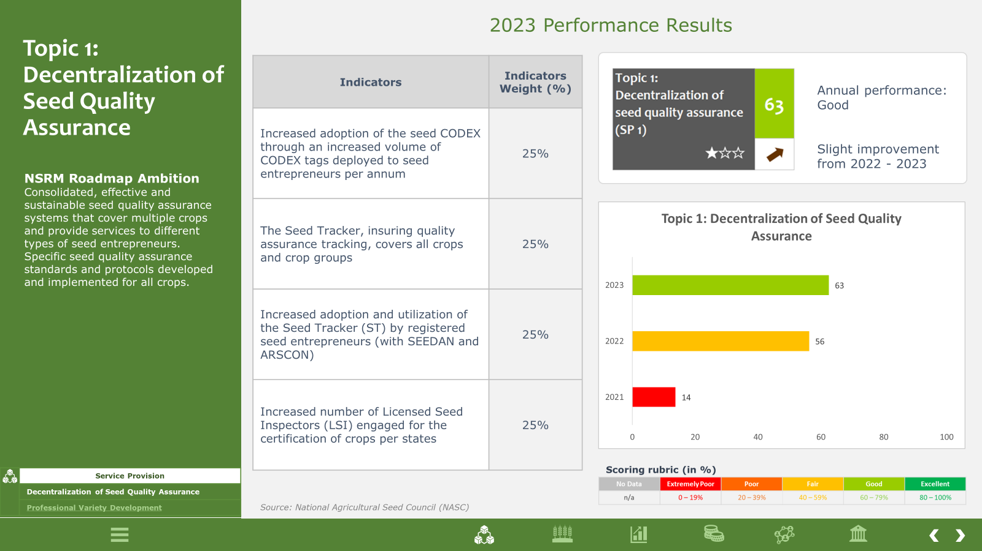
Dashboard navigation
Indicators from the NSRM approved by experts
In bracket is the weighted average
Topic from the NSRM
Result of the annual performance
Function page break
Yearly performances
Overview of sector-wide performance results
Topics
Function
Individual topic performance results
Rubrics for the score
Sector-wide performance overview page
Sources: Experts providing data and scoring
Click for the menu of all the functions.
Hover over the icon to see which function it represents
Back and forward page

Slide 7
Nigerian seed sector dashboard
Sector functions
Seed Sector Performance
2023

Slide 8
Sector functions
1. Seed service provision
2. Seed production systems
3. Seed market development
4. Revenues generation & reinvestment
5. Coordination & governance
6. Regulation & management

Slide 9























Nigeria seed sector performance - 2023
Topic 1: Decentralization of seed quality assurance (SP1)
63
Topic 2: Professional variety development
(SP2)
41
Topic 3: Early generation seed supply (PS1)
59
Topic 4: Infrastructural capacity for seed production & marketing (PS2)
60
Topic 5: Company professionalization & specialization (PS3)
38
Topic 6: Community-based seed production (PS4)
44
Topic 7: Extension on seed & cultivation practices (MD1)
18
Topic 8: Tackling of counterfeit seed (MD2)
60
Topic 9: Seed company marketing & promotion (MD3)
44
Topic 10: Crop value chains & food security policies stimulating seed demand (MD4)
13
Topic 11: Seed distribution networks (MD5)
23
Topic 12: Institutional markets (MD6)
13
Topic 13: Revenue generation for seed quality assurance (RR1)
41
Topic 14: Financial services & products (RR2)
12
Topic 15: Sector governance & coordination (CG1)
63
Topic 16: Seed information (CG2)
48
Topic 17: seed trade association (CG3)
44
Topic 18: Alignment of donor interventions (CG4)
38
Topic 19: Plant variety protection (RM 1)
50
Topic 20: Variety release (RM 2)
58
Topic 21: Seed import (RM3)
20
Topic 22: Seed export (RM4)
13
The arrows illustrate performance from previous year (i.e. 2022 to 2023)

Slide 10
Seed service provision
Decentralization of seed quality assurance
Professional variety development
Back to Top

Slide 11
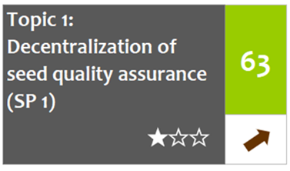
Topic 1: Decentralization of seed quality assurance
2023 Performance results
Indicators
Increased adoption of the seed CODEX through an increased volume of CODEX tags deployed to seed entrepreneurs per annum (25%)
The Seed Tracker, insuring quality assurance tracking, covers all crops and crop groups (25%)
Increased adoption and utilization of the Seed Tracker (ST) by registered seed entrepreneurs (with SEEDAN and ARSCON) (25%)
Increased number of Licensed Seed Inspectors (LSI) engaged for the certification of crops per states (25%)
Annual performance: Good
Slight improvement from 2022 - 2023
NSRM roadmap ambition
Consolidated, effective and sustainable seed quality assurance systems that cover multiple crops and provide services to different types of seed entrepreneurs. Specific seed quality assurance standards and protocols developed and implemented for all crops.
 | Service provision
 | Decentralization of seed quality assurance
 | Professional variety development
Scoring rubric (in %)
Data source: NASC

Slide 12
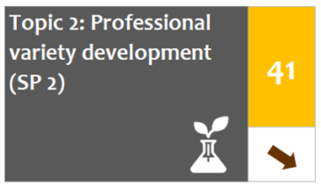
Topic 2: Professional variety development
2023 Performance results
Indicators
Increased number and adequacy of active breeders in Nigeria (30%)
Number of varieties released for small grains (maize, rice, sorghum and millet) per annum (20%)
The average age of the top varieties of grains (maize, rice, sorghum and millet) released and commercialized is decreasing (15%)
Number of varieties released for RTBs (cassava and yam) per annum (20%)
The average age of top varieties of RTBs (cassava and yam) released and commercialized is decreasing (15%)
Annual performance: Fair
Slight regression from 2022 - 2023
NSRM roadmap ambition
Enhanced public capacity for variety development with functional research, farmer and market linkages
 | Service Provision
 | Decentralization of Seed Quality Assurance
 | Professional Variety Development
Scoring rubric (in %)
Data sources: NASC, TASAI, NACGRAB

Slide 13
Seed production systems
Early generation seed supply
Infrastructural capacity for seed prod. & Marketing
Company professionalization & specialization
Community-based seed production
Back to Top

Slide 14
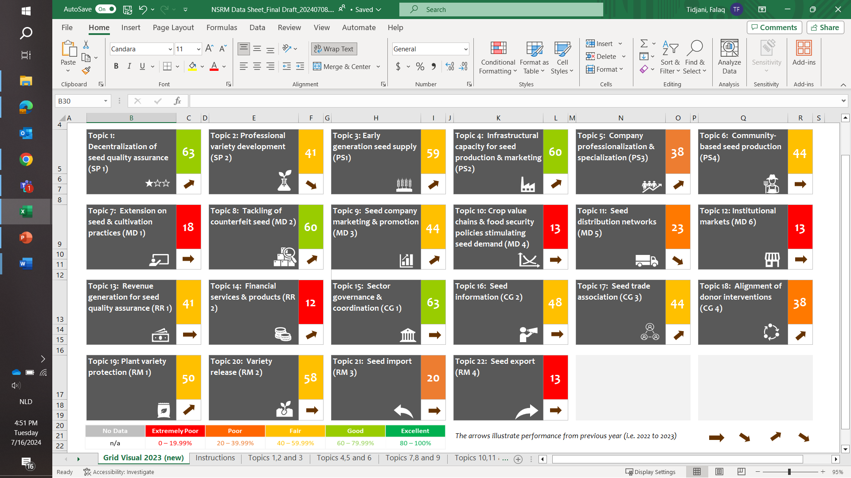
Topic 3: Early generation seed supply
2023 Performance results
Indicators
Seed companies' overall satisfaction of availability of basic (foundation) seed (quality, quantity, timeliness) (25%)
Increased number of seed companies (of NASC licensed entrepreneurs) that specialize in the production and marketing of EGS (35%)
EGS forecasting system operational for at least 5 crops (10%)
Increased number of seed entrepreneurs licensed by NASC (30%)
Annual performance: Fair
Slight improvement from 2022 - 2023
NSRM roadmap ambition
Enhanced commercial and sustainable public and private capacity, structures and processes for early
generation seed (EGS) supply including an operational EGS forecasting system.
 | Production Systems
 | Early generation seed supply
 | Infrastructural capacity for seed production & marketing
 | Company professionalization & specialization
 | Community-based seed production (CBSP)
Scoring rubric (in %)
Data sources: NASC, TASAI

Slide 15
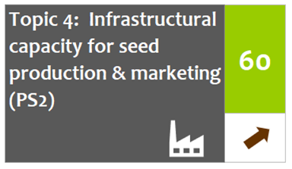
Topic 4: Infrastructural capacity for seed production & marketing
2023 Performance results
Indicators
Increased number of seed entrepreneurs licensed by NASC (40%)
Increased percentage of seed companies/ entrepreneurs that have re-invested and upgraded their infrastructural capacity for production and marketing of quality seed (60%)
Annual performance: Good
Slight improvement from 2022 - 2023
NSRM roadmap ambition
Enhanced infrastructural capacity for the production, processing, storing and marketing of quality seed, including early generation seed (EGS), driven by individual and specific crops or crop groups among seed companies and other seed entrepreneurs, including public research organizations engaged in PPPs for EGS supply.
 | Production systems
 | Early generation seed supply
 | Infrastructural capacity for seed production & marketing
 | Company professionalization & specialization
 | Community-based seed production (CBSP)
Scoring rubric (in %)
Data Sources: NASC, SEEDAN

Slide 16
Topic 5: Company professionalization & specialization
2023 Performance results
Indicators
Number of viable and autonomous business support (BS) service entities that support seed companies covering seed producing regions on a ratio of 1 BS to 3 regions (25%)
Increased number of registered seed companies that currently focus on RTBs and/or vegetables (out of the total number of companies registered with SEEDAN) (25%)
Increased number of seed companies/ entrepreneurs specialised in RTB and/or vegetables, that have reviewed and improved their production and marketing strategy for RTBs and/or vegetables (25%)
Increased number of companies that have specialized and cover at least 3 states with the crop or crop group (RTBs and/or vegetables) (25%)
Annual performance: Good
Slight improvement from 2022 - 2023
NSRM roadmap ambition
Increased professionalization and specialization of seed companies and other seed entrepreneurs in the production and marketing of seed of specific crops or crop groups.
 | Production systems
 | Early generation seed supply
 | Infrastructural capacity for seed production & marketing
 | Company professionalization & specialization
 | Community-based seed production (CBSP)
Scoring rubric (in %)
Data source: SEEDAN

Slide 17
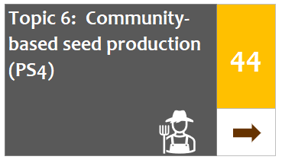
Topic 6: Community-based seed production CBSP
2023 Performance results
Indicators
Increased number of community-based seed producers (CBSP) that are registered with NASC and active in seed production (40%)
The community-based seed producers (CBSP) have a defined structure and defined modalities for quality assurance (35%)
Number of seed producers in CBSP and seed entrepreneurs using to EGS of new varieties through research organisations (25%)
Annual performance: Fair
No improvement/ constant from 2022 - 2023
NSRM roadmap ambition
Strengthened CBSP schemes and local seed entrepreneurs contribute
to the increased availability of quality seeds accessible to farmers; they have evolved into business-oriented, legitimate, legal, institutionally supported and sustainable stakeholders in the production and marketing of quality seed; CBSP schemes and local seed entrepreneurs have structural linkages with public research organizations for access to new improved varieties, EGS and other technologies…
 | Production Systems
 | Early generation seed supply
 | Infrastructural capacity for seed production & marketing
 | Company professionalization & specialization
 | Community-based seed production (CBSP)
Scoring rubric (in %)
Data sources: NASC, NARIs

Slide 18
Seed market development (SMD)
Extension on seed & cultivation practices
Tackling of counterfeit seed
Seed company marketing & promotion
Crop value chains & food security policies
Seed distribution networks
Institutional markets
Back to Top

Slide 19
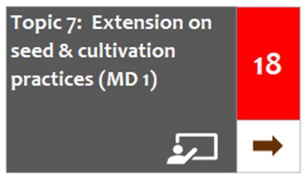
Topic 7: Extension on seed & cultivation practices
2023 Performance results
Indicators
Number/percentage of seed companies with qualified extension officers (35%)
Seed industry satisfaction with extension officers (35%)
NASC and NAERLS collaborate to license (improved) seed specific extension officers (30%)
Annual performance: Extremely poor
No improvement from 2022 - 2023
NSRM roadmap ambition
Enhanced public and private extension services that promote farmers’ use of quality seed of improved varieties combined with advanced cultivation practices
 | Seed Market Development
 | Extension on seed & cultivation practices
 | Tackling of counterfeit seed
 | Seed company marketing & promotion
 | Crop value chains & food security policies stimulating seed demand
 | Seed distribution networks
 | Institutional markets
Scoring rubric (in %)
Data sources: TASAI, NASC, NAERLS

Slide 20
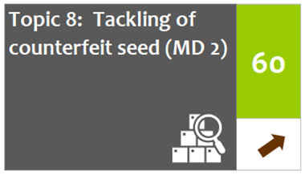
Topic 8: Tackling of counterfeit seed
2023 Performance results
Indicators
Seed industry satisfaction with government efforts to address counterfeit seed (30%)
The counterfeit reporting system has been developed and is fully functional (40%)
Number of seed market surveillance and enforcement carried out covers multiple states per annum (30%)
Annual performance: Good
Slight improvement from 2022 - 2023
NSRM roadmap ambition
Increased enforcement of quality assurance and penalties for counterfeit seed marketing; reduced engagement in the marketing of fake seed by seed companies and agro-dealers; reduced profitability of counterfeiting and thereby reduced viability of non-genuine seed companies and agro-dealers; increased farmers’ trust in seed companies and agro-dealers.
 | Seed Market Development
 | Extension on seed & cultivation practices
 | Tackling of counterfeit seed
 | Seed company marketing & promotion
 | Crop value chains & food security policies stimulating seed demand
 | Seed distribution networks
 | Institutional markets
Scoring rubric (in %)
Data sources: NASC, TASAI

Slide 21
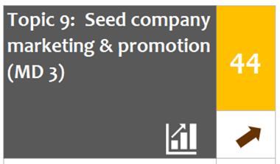
Topic 9: Seed company marketing & promotion
2023 Performance results
Indicators
Increased number of registered and active seed companies/ entrepreneurs with SEEDAN (20%)
Number of domestic seed companies that have a percentage of their annual budget and/or invest in seed marketing and promotion (25%)
Number of international and domestic seed companies that implement awareness raising activities promoting use of quality seed (25%)
Increase of the percentage of small-scale farmers reached directly, with the marketing and promotion, by the seed entrepreneurs – compared with the previous year (30%)
Annual performance: Fair
Slight improvement from 2022 - 2023
NSRM roadmap ambition
Increased and more structural investment by seed companies in the marketing and promotion of quality seed and improved varieties that results in an increased awareness of farmers and enhanced willingness to pay for quality seed and improved varieties
 | Seed Market Development
 | Extension on seed & cultivation practices
 | Tackling of counterfeit seed
 | Seed company marketing & promotion
 | Crop value chains & food security policies stimulating seed demand
 | Seed distribution networks
 | Institutional markets
Scoring rubric (in %)
Data source: SEEDAN

Slide 22
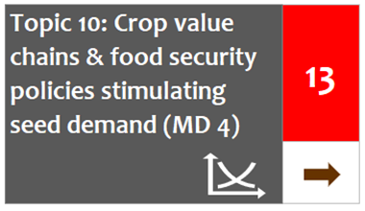
Topic 10: Crop value chains & food security policies stimulating seed demand
2023 Performance results
Indicators
Agricultural produce prices are monitored and informed policies are developed and implementation to stabilize markets (50%)
Increasing purchase and use of quality seed and new varieties of cash crops (i.e. rice, maize and tomato) by farmers (50%)
Annual performance: Extremely poor
No improvement from 2022 - 2023
NSRM roadmap ambition
Enhanced food security policies and more stable prices in grain and crop markets increase farmers’
profitability and enable their investment in the production of food crops, thus contributing to increased use of inputs such as quality seed of improved varieties
 | Seed Market Development
 | Extension on seed & cultivation practices
 | Tackling of counterfeit seed
 | Seed company marketing & promotion
 | Crop value chains & food security policies stimulating seed demand
 | Seed distribution networks
 | Institutional markets
Scoring rubric (in %)
Data sources: NASC, FMAFS

Slide 23
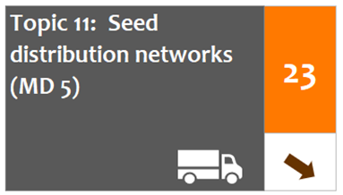
Topic 11: Seed distribution networks
2023 Performance results
Indicators
Number of agro-dealers that are licensed by the NASC network and abide by seed quality assurance regulations (30%)
Increased number of agro-dealers trained and aware of the adequate seed handling -by NASC (30%)
All new entrants (agro-dealers) in the seed sector are trained by NASC (20%)
SEEDAN provides tailored business support to registered agro-dealers (20%)
Annual performance: Poor
Slight regression from 2022 - 2023
NSRM roadmap ambition
Enhanced capacity of agro-dealer networks in the marketing of adequate quantities of quality seed of improved and demanded varieties of multiple crops, at the right time and affordable price
 | Seed Market Development
 | Extension on seed & cultivation practices
 | Tackling of counterfeit seed
 | Seed company marketing & promotion
 | Crop value chains & food security policies stimulating seed demand
 | Seed distribution networks
 | Institutional markets
Scoring rubric (in %)
Data sources: NASC, SEEDAN

Slide 24
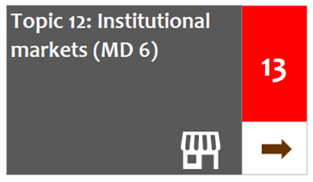
Topic 12: Institutional markets
2023 Performance results
Indicators
Decreased number of subsidy programmes by the government (federal and state), NGOs for the seed sector (40%)
Institutional markets using good practices for procurement and distribution of quality seed (40%)
Stakeholders (companies and institutional buyers) satisfaction of the functioning of the seed institutional markets (20%)
Annual performance: Extremely poor
No improvement from 2022 - 2023
NSRM roadmap ambition
Increased demand- and market-driven, dynamic and functioning seed sector that operates sustainably with minimal government, NGO and project subsidies and interventions; if interventions are made, they
promote accountability and sustainability
 | Seed Market Development
 | Extension on seed & cultivation practices
 | Tackling of counterfeit seed
 | Seed company marketing & promotion
 | Crop value chains & food security policies stimulating seed demand
 | Seed distribution networks
 | Institutional markets
Scoring rubric (in %)
Data source: Sahel Consulting

Slide 25
Revenues generation & reinvestment (RR)
Revenue generation for seed quality assurance
Financial services & products
Back to Top

Slide 26
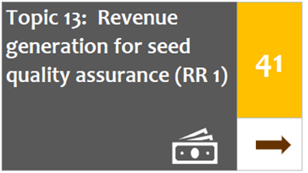
Topic 13: Revenue generation for seed quality assurance
2023 Performance results
Indicators
Reforms for NASC’s financing of its seed quality assurance services based on direct remuneration has been completed (35%)
Seed companies report improvement in the efficiency and effectiveness of NASC quality assurance service delivery (30%)
The percentage of private LSI increases as compared to total number of NASC employed seed inspectors (Private LSI directly paid by seed companies for their services) (35%)
Annual performance: Fair
No improvement/ constant from 2022 - 2023
NSRM roadmap ambition
Enhanced efficiency and effectiveness of the NASC in delivering seed quality assurance services, which are supported by a sustainable mechanism for generating revenues
 | Revenues Generation & Reinvestment Topics
 | Revenue generation for seed quality assurance
 | Financial services & products
Scoring rubric (in %)
Data sources: NASC, SEEDAN

Slide 27
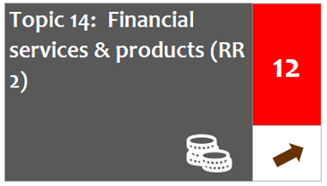
Topic 14: Financial services & products
2023 Performance results
Indicators
Increased number of commercial banks/ financial institutions that offer seed sector adapted financial products and services (50%)
Increased number of licensed seed entrepreneurs by NASC (10%)
Increased percentage of licenced (by NASC) seed entrepreneurs that have benefited from the financial products and services (40%)
Annual performance: Poor
Slight improvement from 2022 - 2023
NSRM roadmap ambition
Enhanced availability of financial services and products tailored for seed business, and their increased use by seed companies and producers in production and marketing operations
 | Revenues Generation & Reinvestment Topics
 | Revenue generation for seed quality assurance
 | Financial services & products
Scoring rubric (in %)
Data sources: NASC, SEEDAN

Slide 28

Coordination & governance (CG)
Sector Governance & Coordination
Seed Information
Seed Trade Association
Alignment of Donor Interventions
Back to Top

Slide 29
Topic 15: Sector governance & coordination
2023 Performance results
Indicators
The national seed sector platform and others (i.e. the national seed planning meeting, the national seed fair and the seed connect) are institutionalised, and fostering collaborations (25%)
Track and report key industry data & trends to inform policy-driven decision making by the state and national governments and other stakeholders (25%)
Track seed sector investments and programmes within the seed sector to foster alignment, and facilitate collaborations in accordance with the NSRM/others strategic documents (25%)
The NASC strategy document(s) is used as a guiding tool to improve its capability for industry governance and coordination (25%)
Annual performance: Fair
No improvement/ constant from 2022 - 2023
NSRM roadmap ambition
Enhanced governance of the seed sector with institutional responsibilities for governance and regulation; a structured and functional National Seed Sector Platform; a collaborative and sector-driven implementation of the NSRM; and improved coordination between public and private stakeholders in seed sector development
 | Coordination & Governance
 | Sector governance & coordination
 | Seed information
 | Seed trade association
 | Alignment of donor interventions
Scoring rubric (in %)
Data source: NASC

Slide 30
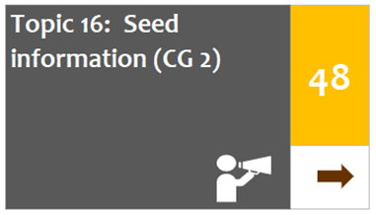
Topic 16: Seed information
2023 Performance results
Indicators
Digitalize key services and operations of NASC (30%)
NASC’s seed databank and Knowledge Management System (KMS) is developed and fully operational to store and disseminate industry information (40%)
NASC develops and disseminates annual reports with sector information and developments (30%)
Annual performance: Fair
No improvement from 2022 - 2023
NSRM roadmap ambition
Increased availability and reliability of information on seed and seed business for all stakeholders; enhanced access to and use by stakeholders of accurate industry and market information, which supports proper production planning, marketing and promotion of new varieties, EGS forecasting and supply, seed quality assurance and financial services tailored to the seed sector; increased efficiency and effectiveness of the sector through the use of modern systems for seed information management and sharing (IMS)
 | Coordination & Governance
 | Sector governance & coordination
 | Seed information
 | Seed trade association
 | Alignment of donor interventions
Scoring rubric (in %)
Data source: NASC

Slide 31
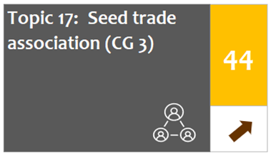
Topic 17: Seed trade association
2023 Performance results
Indicators
Increased in the number of seed companies registered as members of SEEDAN (25%)
SEEDAN have registered at least 5 international seed companies (25%)
SEEDAN has revised its structure with sub-chapters and developed its operating working document including its structure and services (25%)
Actively participate in the African Seed Trade Association (AFSTA) and/or the International Seed Federation (ISF) meetings (25%)
Annual performance: Fair
Slight improvement from 2022 - 2023
NSRM roadmap ambition
Enhanced structure, functioning and governance of SEEDAN, ensuring coverage and representation of all
agricultural zones, crops and business types
 | Coordination & Governance
 | Sector governance & coordination
 | Seed information
 | Seed trade association
 | Alignment of donor interventions
Scoring rubric (in %)
Data source: SEEDAN

Slide 32
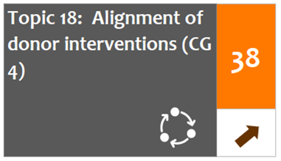
Topic 18: Alignment of donor interventions
2023 Performance results
Indicators
Number of seed sector interventions by different development partners contributing to the NSRM/Seed strategy document (50%)
Donor organisations, public and private sector stakeholders hold annual (e.g. ADWG, Seed Connect, Seed Fair) or bi-annual meetings to discuss programmes and opportunities for seed sector interventions (50%)
Annual performance: Poor
Slight improvement from 2022 - 2023
NSRM roadmap ambition
Enhanced governance of the seed sector with institutional responsibilities for governance and regulation; a structured and functional National Seed Sector Platform; a collaborative and sector-driven implementation of the NSRM; and improved coordination between public and private stakeholders in seed sector development
 | Coordination & Governance
 | Sector governance & coordination
 | Seed information
 | Seed trade association
 | Alignment of donor interventions
Scoring rubric (in %)
Data source: NASC

Slide 33
Regulation & management (RM)
Plant Variety Protection
Variety Release
Seed Import
Seed Export
Back to Top

Slide 34
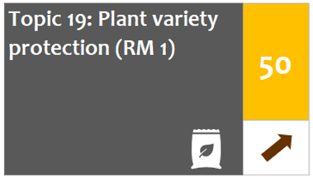
Topic 19: Plant variety protection
2023 Performance results
Indicators
The signed and assented PVP Bill is fully functional and implemented using tailored regulations and guidelines (35%)
Nigeria has become a member of UPOV through the advocacy efforts of NASC (30%)
PVP office and DUS testing facilities established and operational (35%)
Annual performance: Fair
Slight improvement from 2022 - 2023
NSRM roadmap ambition
Adopted Plant Variety Protection Bill; operational UPOV-PVP system that supports the development of the seed sector
 | Coordination & Governance
 | Plant variety protection
 | Variety release
 | Seed import
 | Seed export
Scoring rubric (in %)
Data source: NASC

Slide 35
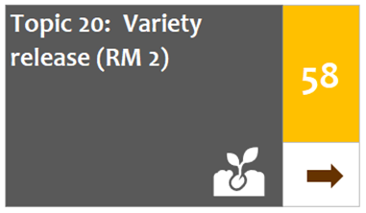
Topic 20: Variety release
2023 Performance results
Indicators
Average length of variety release process (in months) by industry stakeholders is reduced (15%)
Satisfaction rating of variety release process by industry stakeholders has improved (15%)
The cost of variety release process for maize, including VCU and on-farm testing (20%)
The cost of variety release process for Tomato (only on-farm testing) (20%)
Increased number of improved varieties released for all crops, per annum (10%)
Established alignment between the Nigerian and ECOWAS regulation leading to release of new crops varieties (10%)
Annual performance: Fair
No improvement from 2022 - 2023
NSRM roadmap ambition
Increased efficiency and transparency in variety release procedures with a more realistic cost-benefit ratio (regulation & management; service provision; revenue generation & reinvestment); enforced ECOWAS
harmonization on variety release that supports private sector investment (regulation & management)
 | Coordination & Governance
 | Plant variety protection
 | Variety release
 | Seed import
 | Seed export
Scoring rubric (in %)
Data sources: NASC, TASAI, NACGRAB, CSP

Slide 36
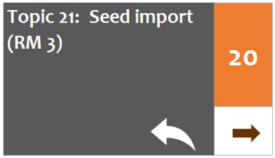
Topic 21: Seed import
2023 Performance results
Indicators
The seed import/export portal is developed and fully functional (40%)
Import tariffs for seed reviewed and approved for all crops (20%)
Number of (manual) import permits issued by NASC has increased for all crops (40%)
Annual performance: Poor
No improvement from 2022 - 2023
NSRM roadmap ambition
Increased efficiency, predictability and transparency of seed import procedures and conditions at ports
and borders, supported by a one-stop digital portal, that enables seed business development (regulation & management; service provision); zero-import tariffs applied to seed of selected crops, similar to other
agricultural inputs
 | Coordination & Governance
 | Plant variety protection
 | Variety release
 | Seed import
 | Seed export
Scoring rubric (in %)
Data sources: NAQS, NASC

Slide 37
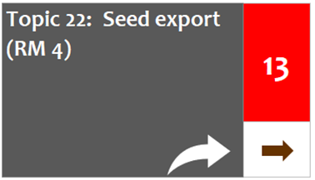
Topic 22: Seed export
2023 Performance results
Indicators
The seed import/export portal is developed and fully functional (50%)
Number of registered seed companies that export seeds (50%)
Annual performance: Extremely poor
No improvement from 2022 - 2023
NSRM roadmap ambition
Membership of the NASC with international bodies like UPOV and the OECD Seed Scheme, established
and consolidated, thereby supporting seed export; one-stop portal established for seed export
 | Coordination & Governance
 | Plant variety protection
 | Variety release
 | Seed import
 | Seed export
Scoring rubric (in %)
Data sources: NAQS, NASC

Slide 38
Contact us: info@seedcouncil.gov.ng
Nigerian seed sector development roadmap dashboard
For more information
Back to top

